Slide 1

Exploratory Data Analysis

Slide 2
EDA Defined
Tenderly Read Chapter 5
Know the Process
Respect the Process
Data
Question
Visualize Summarize
Question
Model

Slide 3
Data
Example: Wages
“Ecdat” R Package
Sample from 1987
3,294 Workers
48% Female
Variables
Experience (Yrs.)
Sex (M or F)
School (Yrs.)
Wage (Hourly in $)

Slide 4
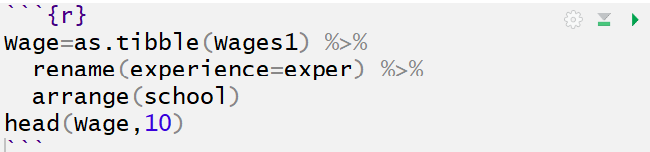
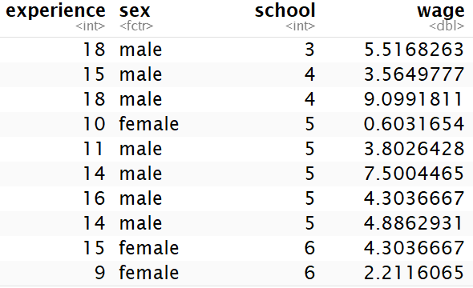
Data
Verbeek, Marno (2004) A Guide to Modern Econometrics, John Wiley and Sons.

Slide 5
Questions
Think Creatively
Quantity and Quality
General:
What type of variation occurs within my variables?
What type of covariation occurs between my variables?

Slide 6
Questions
Variation
Variable = Quantity, Quality, or Property You Can Measure
Reason: Values Tend to “Vary”
People
Categorical:
Eye Color
Occupation
Numerical:
Salary
Hair Count
Goal: Explain Variation

Slide 7
Questions
Covariation
Describes the Behavior Between Variables
We Often Attempt to Explain Variation Within by Looking at Covariation Between

Slide 8
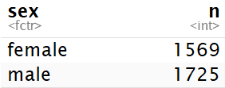
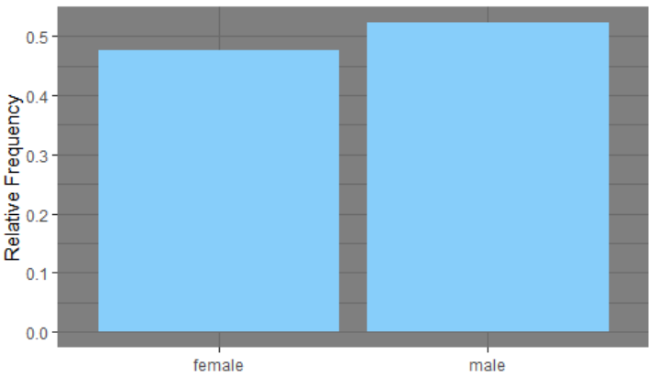
Questions
Variation Visualized
Example: Wages
Categorical: Sex

Slide 9

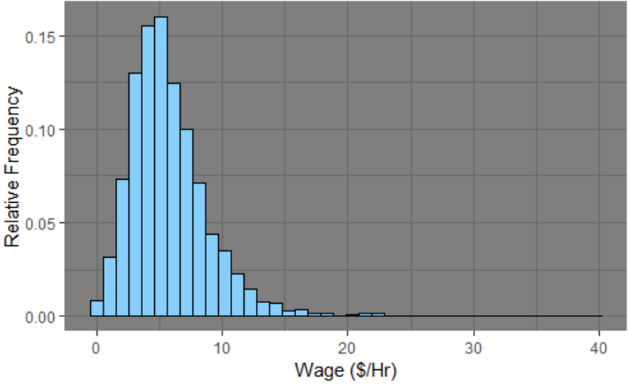
Questions
Variation Visualized
Example: Wages
Numerical: Hourly Wage

Slide 10
Questions
Variation Visualized
Example: Wages
Numerical: Hourly Wage

Slide 11
Closing
Disperse and Make Reasonable Decisions

